Slide 1

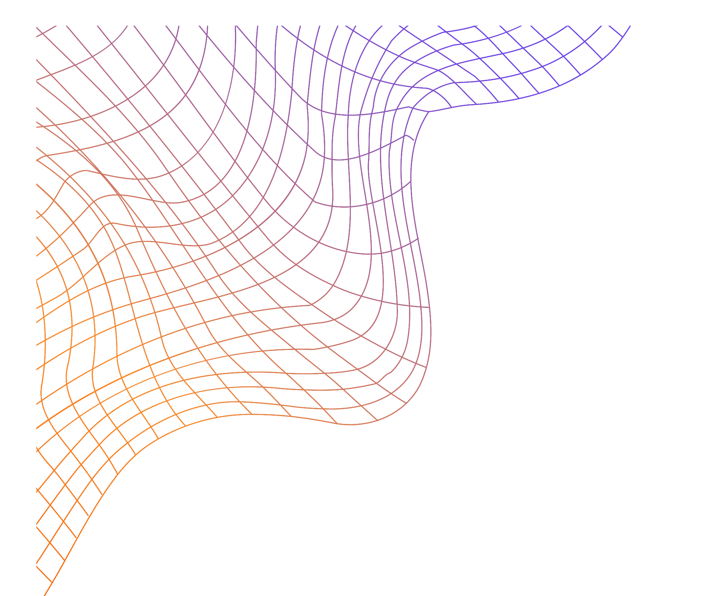
Effect of Stochastic Gate Noise on Fault-Tolerant Surface Codes
Cherilyn Lee Gabriela Christen, Nathaniel James Pacey
In work under EPFL supervising Professor. Nicolas Macris
Notes:
Topic:
Effect of Stochastic Gate Noise on Fault-Tolerant Surface Codes
Motivation:
Current quantum computers are not fault-tolerant
Environmental noise leads to decoherence and errors
Goal:
Enable large-scale algorithms using many fault-tolerant qubits
Solution Approach:
Use of quantum error correction, specifically surface codes
Surface codes: 2D lattice structure suitable for hardware, Encode logical qubits using multiple physical qubits
Our Contribution:
Develop/improve realistic stochastic noise simulations
Analyze impact of gate noise on surface code performance
Support design of more robust fault-tolerant quantum systems

Slide 2
Table of contents
01.
02.
03.
04.
05.
06.
Stabilizer Code
Surface Code
Stochastic Noise
Fundamentals of quantum error correction
Error Detection Through Lattice-Based Syndromes
Realistic Noise Implementation based on Noisy Quantum Gates
Noise extension
Results
Future Work
Custom Noise Extensions and Added Functionality
Analysis of Custom Noise Implementation &
Comparison to Qiskit Simulations
Surface Code Extensions &
Potential Noisy Gates Library Improvements
2

Slide 3
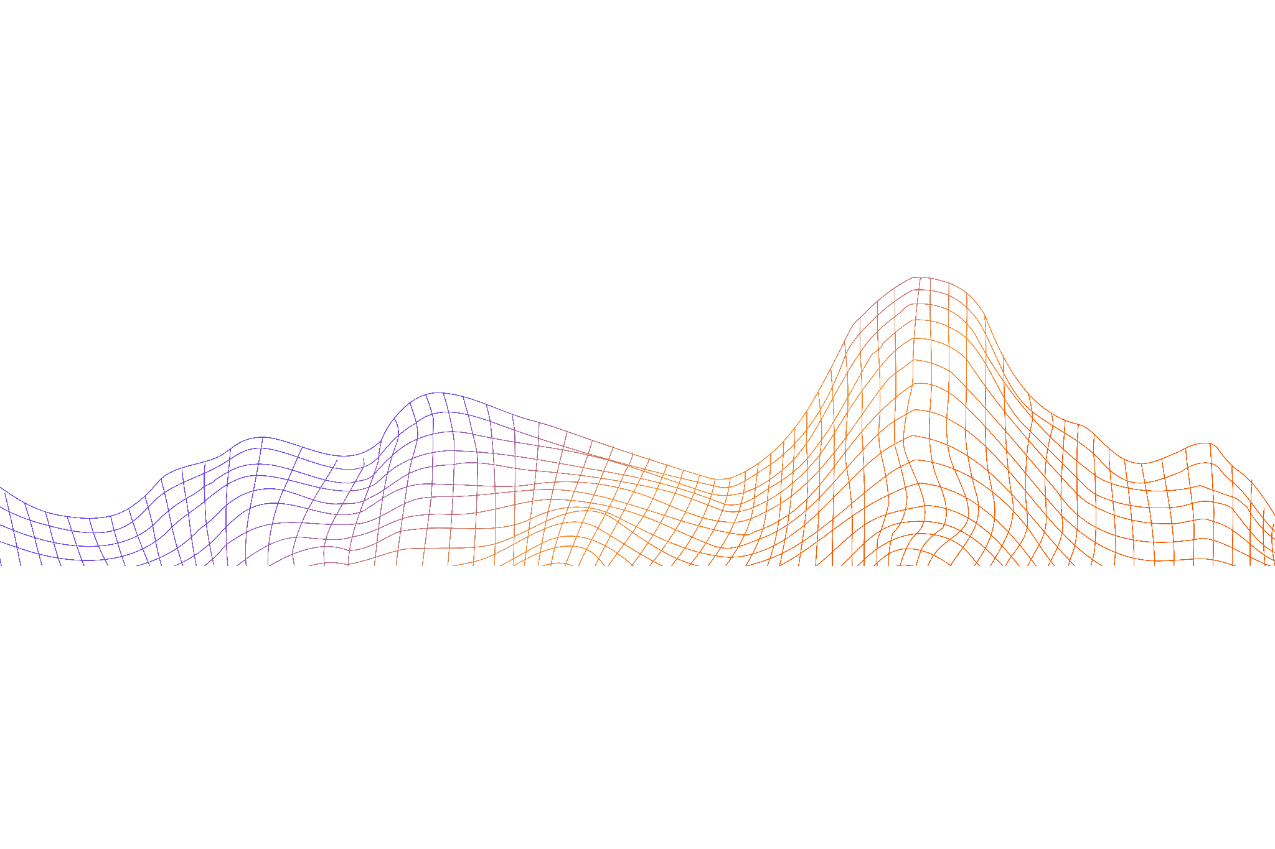
01.
Stabilizer Code
Fundamentals of quantum error correction
3

Slide 4
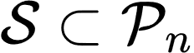
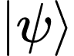
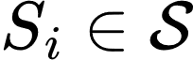
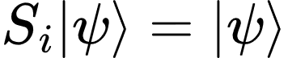

Stabilizer Code Basics
A stabilizer code defines a subspace of the n-qubit Hilbert space using an abelian subgroup of the Pauli group
A codeword is any state stabilized by all :
has n-k independent generators; it encodes k logical qubits into n physical qubits
Logical operators commute with all , but are not in
Error Detection:
If E commutes with Sᵢ → +1: error undetected
If E anti-commutes with Sᵢ → −1: error detected
4
*Equantions based on: Stabilizer Codes and Quantum Error Correction. [5]

Slide 5
02.
Surface Code
Error Detection Through Lattice-Based Syndromes
5

Slide 6
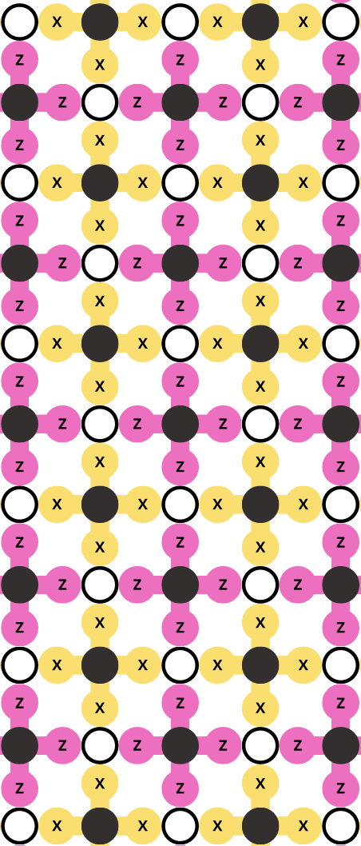
Surface Code Structure
Topological stabilizer code defined on a 2D lattice
Data qubits encoded quantum information
Measurement (ancilla) qubits extract error syndromes
Each measurement qubit:
Interacts with 4 neighboring data qubits
Implements measure-X (detects bit-flips) or measure-Z (detects phase-flips)
Each data qubit connects to 2 measure-X and 2 measure-Z qubits
Provides full single-qubit error coverage
6
*Diagram based on: Surface codes: Towards practical large-scale quantum computation. [1]

Slide 7
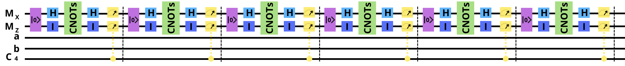
Surface Code Cycles
Surface code operation proceeds in repeated measurement cycles
After each cycle, the ancilla qubits are measured
Once all stabilizer measurements are complete, the data qubits are projected into a state that simultaneously satisfies all measured eigenvalue constraints, this is known as the quiescent state
These cycles are repeated, and in the absence of errors, the quiescent state remains stable due to the commutation of all stabilizers
7

Slide 8
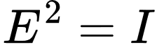

Surface Code Errors
Focus on error detection rather than direct error correction
Physical corrections are only applied if an error affects a measurement outcome; otherwise, errors are tracked in software
Errors neutralize themselves when they reoccur in the same way since for being any Pauli operator {I,X,Y,Z}
A Pauli-𝑋 error on the data qubit anticommutes with the 𝑍-type stabilizer, and thus will be detected as a change in the corresponding measurement outcome
A Pauli-𝑍 error anticommutes with the 𝑋-type stabilizer and is similarly flagged by a measurement flip.
8

Slide 9
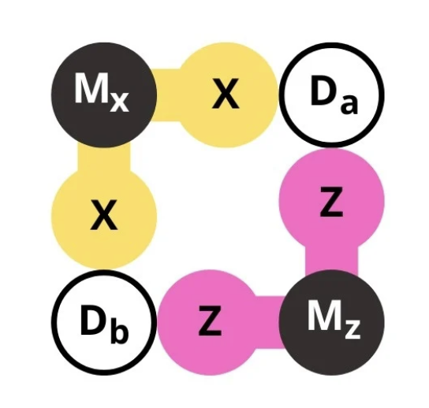
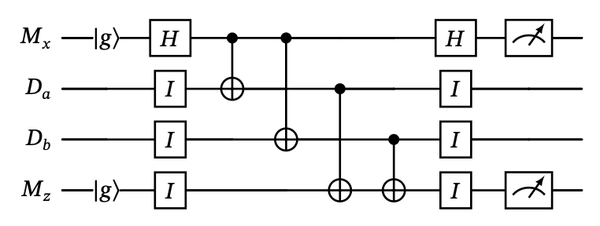
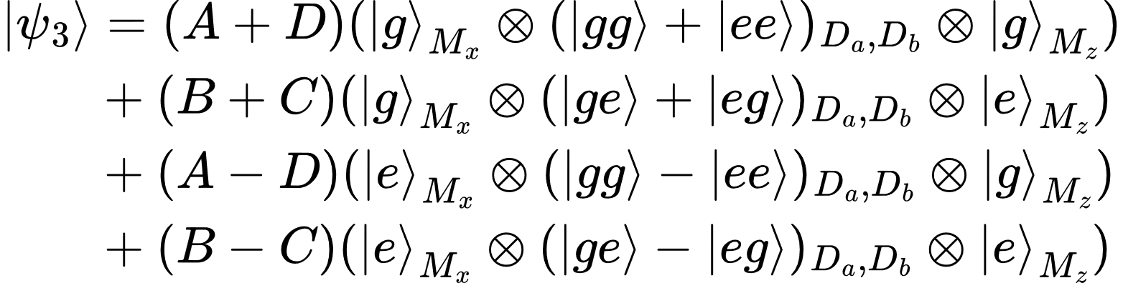
4 Qubit Example
Initial State of data qubits: with
Initial State of all qubits:
Apply the Hadamard gate to the X measurement qubit to change the basis:
Apply the CNOT gates to create the entangled states :
Apply the Hadamard gate to the X measurement qubit to change the basis:
9
*Equantions based on: Surface codes: Towards practical large-scale quantum computation. [1]

Slide 10
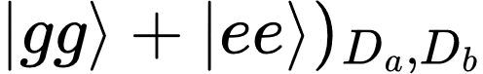
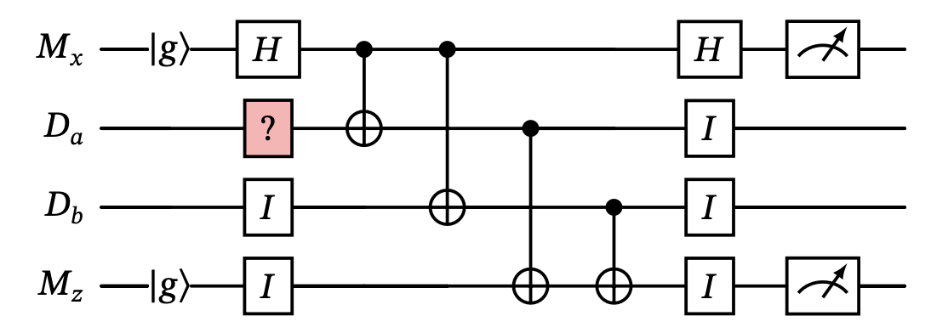
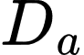
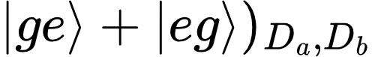
Errors on 4 Qubit Example
The quiescent state was determined to be in cycle 1
Having a X error on in the next cycle results in a state
The measurement outcome is {+1,-1}
10
*Equantions based on: Surface codes: Towards practical large-scale quantum computation. [1]

Slide 11
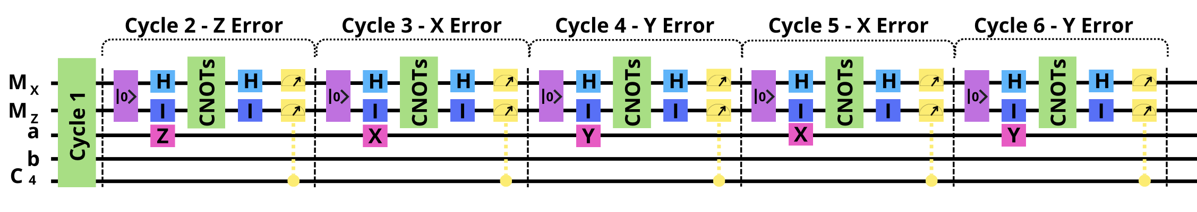
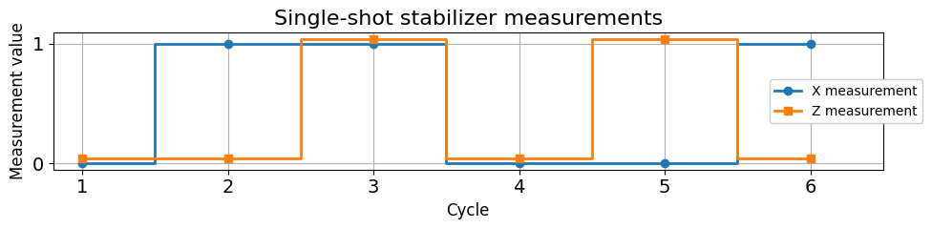
Errors on 4 – Qubit Example
11

Slide 12
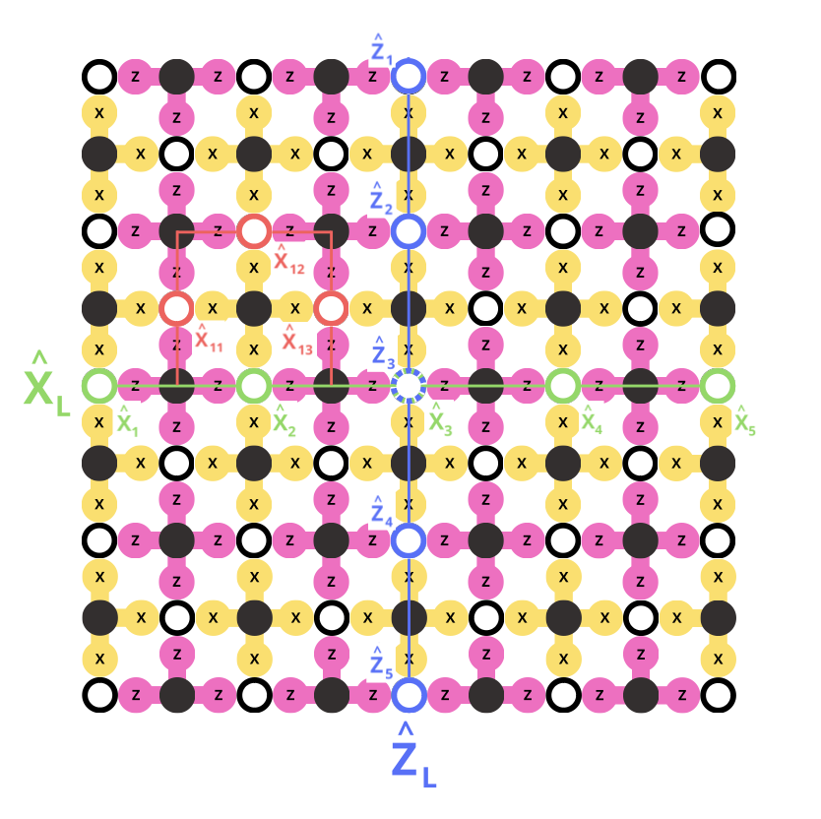
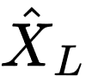
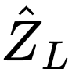
Surface Code Logical Qubit
A logical qubit in the surface code is defined using the degrees of freedom that remain after imposing all stabilizer constraints.
Logical operators and are constructed as products of single-qubit Pauli operators that commute with all stabilizers but are not themselves stabilizers.
12
*Diagram based on: Surface codes: Towards practical large-scale quantum computation. [1]

Slide 13
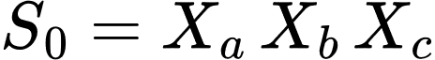
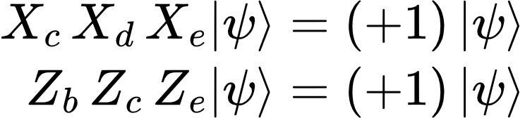
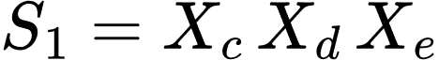
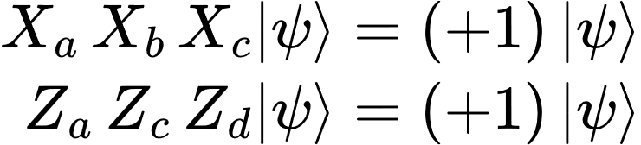
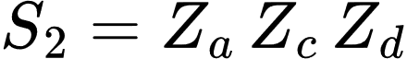
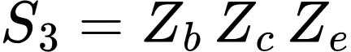
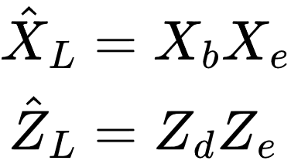
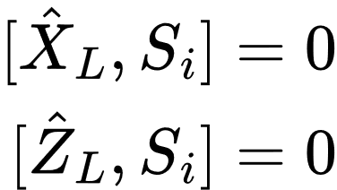
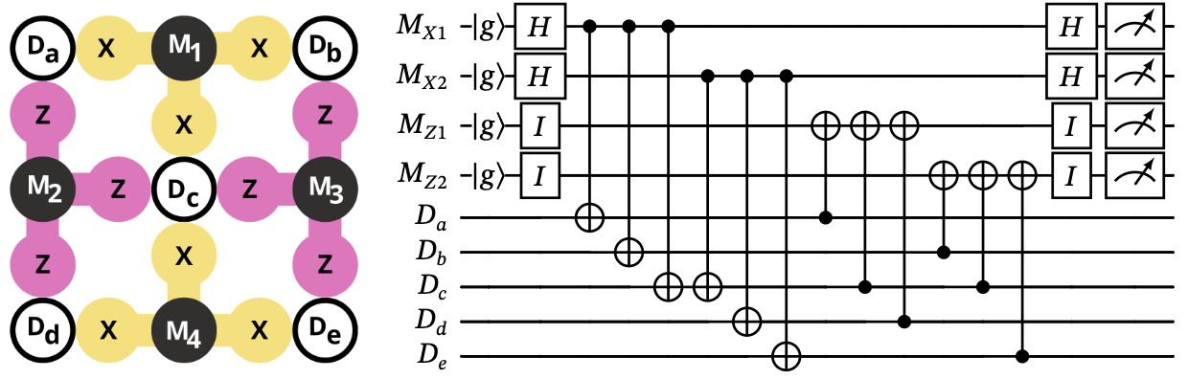
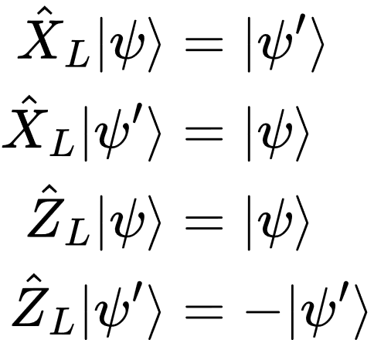
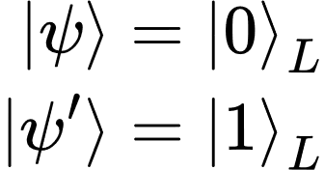
9 Qubit Example
Since :
Experimentally it can be found that satisfy the above equations
Defining the Logical Operators as
X
L
one can see that
Z
L
13
*Equantions based on: Surface codes: Towards practical large-scale quantum computation. [1]

Slide 14
03.
Stochastic Noise
Realistic Noise Implementation based on Noisy Quantum Gates
14

Slide 15

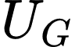

Traditional Noise
15

Slide 16
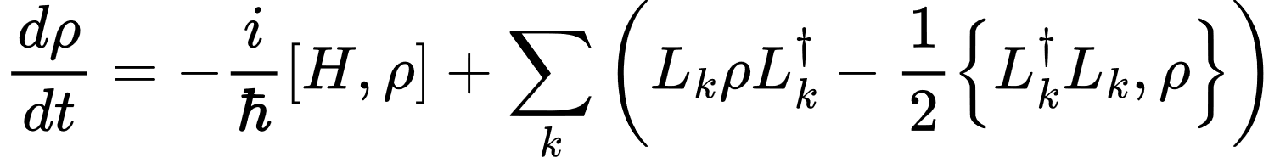
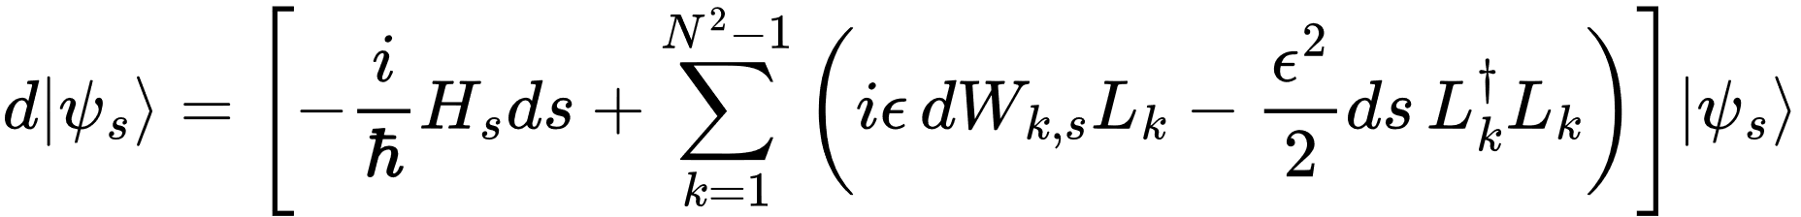
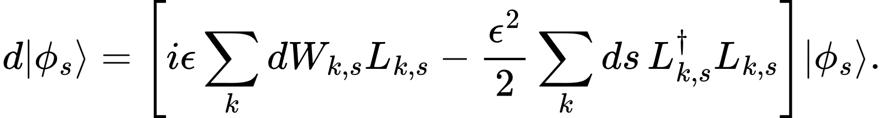
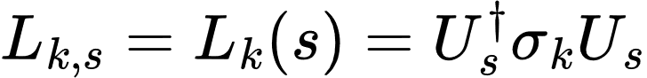
Lindblad Formalism
Lindblad formalism describes the non-unitary dynamics of open quantum systems under Markovian decoherence
Lindblad-type master equation:
Itô stochastic differential equation for the state evolution:
Transforming this into the interaction picture:
16
*Equantions from: Noisy gates for simulating quantum computers [2].

Slide 17
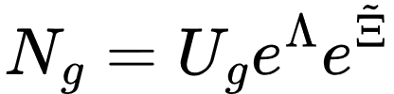
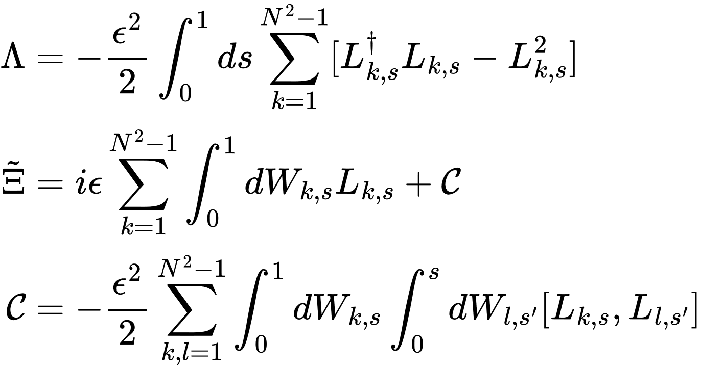
Noisy Gate
Deterministic term
Stochastic term
(full derivation in report)
17
*Equantions from: Noisy gates for simulating quantum computers [2].

Slide 18
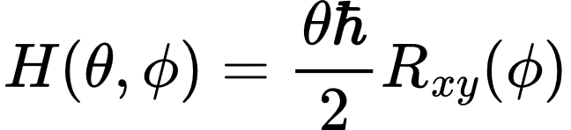
Noisy Gates Single Qubit Noise
18
*Equantions from: Noisy gates for simulating quantum computers [2].

Slide 19
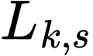
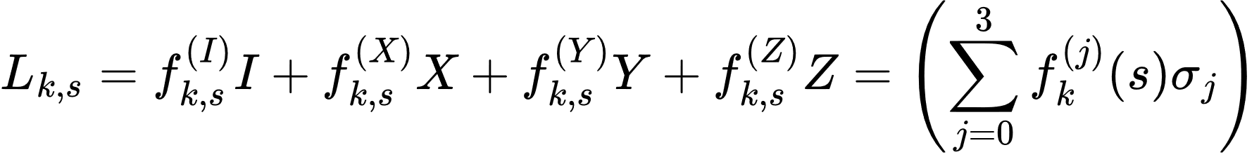
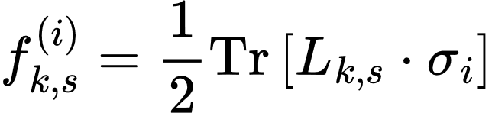
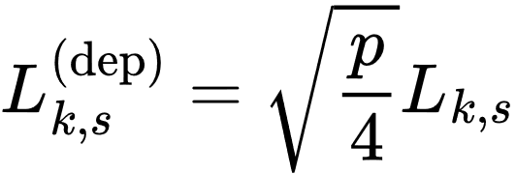
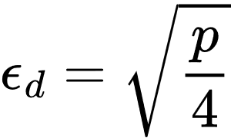
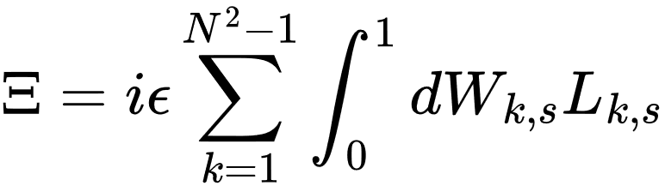
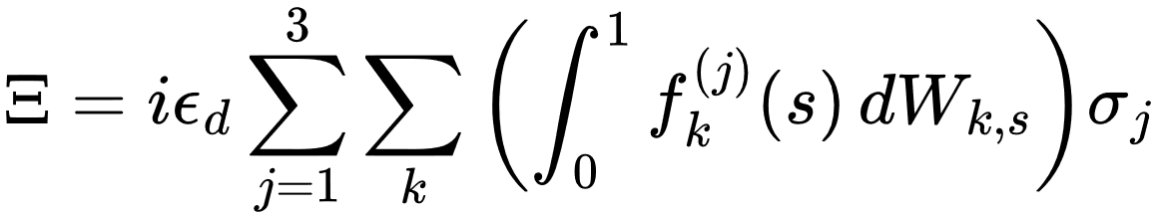
Depolarizing Noise
Lindblad operator as a linear combination of the Pauli basis {I, X, Y, Z}
For the depolarizing channel specifically, the noise model is described by three time-dependent Lindblad operators:
Substituting into :
19
*Equantions based on: Noisy gates for simulating quantum computers [2].
Notes:
For each L of k (defined by UoU), where k is the single qubit gate (Pauli) evaluated, we can break down the resulting matrices in terms of pauli operators and a function f
Define f as ½ the Trace of the L times the respective Pauli
We can see how in this picture for each noise contribution we have equal probability (p depolarizing probability)
Can then write depolarizing noise in terms of these functions f for each pauli component (and each gate)

Slide 20
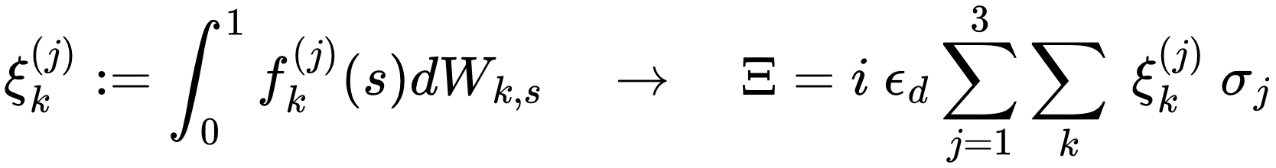
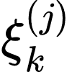

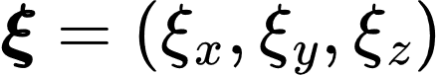







Depolarizing Noise
Define a real stochastic variable such that
To fully characterize the distribution of , we compute the covariance matrix
The covariance matrix expands to
The full stochastic noise term is constructed by decomposing it into contributions , and associated with each Pauli direction
(A full derivation and several examples are in the report)
20
*Equantions based on: Noisy gates for simulating quantum computers [2].
Notes:
If we take Zeta, to be the Ito integral of f (wrt dW, the increment of Brownian motion) we can write a condensed Xi in terms of Zeta where then the X, Y, Z component of Xi map to zeta and make up the covariance matrix of which we sample (theta) over
Sample just the expectation of combinations of zeta, where hen i=j covariance = variance

Slide 21







Additional Noise
Stochastic noise:
Depolarizing
Amplitude Damping
Phase Damping
*Source: Paweł Cisło, Industrial Engineering
Type of Model (Deterministic, Stochastic, Noise)
Deterministic Noise
21
*Equantions based on: Noisy gates for simulating quantum computers [2].

Slide 22
04.
Noise Extension
Beyond Noisy-Gates: Custom Noise Extensions and Added Functionality
22

Slide 23




Noise Extensions
Apply noise to each type of 1-qubit gate individually
23

Slide 24



Measurement Implementation
Custom measurement routine in QuTiP. For an 𝑁-qubit state |𝜓⟩ and a target qubit 𝑖, the code constructs the projectors:
The Born-rule probabilities are then evaluated as
24

Slide 25

Noisy Reset Gate Implementation
The noisy-gates library lacks native support for noisy resets resets critical for surface code cycles.
A custom noisy reset was implemented to simulate realistic error conditions.
Approach:
Perform a projective measurement on the qubit.
If outcome is ∣1⟩, apply a noisy 𝑋 gate to reset to ∣0⟩.
Otherwise return |𝜓⟩ .
Enables repeated stabilizer cycles with more physically accurate reset behavior.
Reset Gate
25

Slide 26


Noisy Hadamard Gate Implementation
Our framework applies noise individually to each gate
Only 1-qubit gates are Reset and Hadamard
We construct the noisy Hadamard gate, by combining the noisy 𝑋 and 𝑍 gates.
26

Slide 27
05.
Results
Analysis of Custom Noise Implementation &
Comparison to Qiskit Simulations
27

Slide 28




Effect of Noise Model over on Measurement Outcomes
Analysis of Custom Noise Implementation
28

Slide 29





Single-Cycle Surface Code Behavior Under Varying Noise
Analysis of Custom Noise Implementation
Generally: for a non-noisy mixed state
But for a noisy state
But stochastic noise is trace-preserving in expectation
29

Slide 30




Analysis of Custom Noise Implementation
30

Slide 31





Analysis of Custom Noise Implementation
Fidelity Metric To quantify closeness, we compute the fidelity Running Mean Fidelity To observe convergence over repeated shots Closeness to Perfect Fidelity
31
*Equantions based on: Noisy gates for simulating quantum computers [2].

Slide 32

Sensitivity of Error Metrics to Device Parameters
Stochastic noise increases with gate duration due to time-integrated decoherence from Lindblad dynamics.
32

Slide 33

Sensitivity of Error Metrics to Device Parameters
Increasing depolarizing noise strength leads to lower fidelity and greater trace deviation due to enhanced randomization of the quantum state.
33

Slide 34




Effects of noise model over many surface code cycles’ trajectory
Comparison to Qiskit Noise Simulation
Reset Gate
34

Slide 35

Comparison of absolute fidelity of Qiskit noise model and stochastic noise model over a range of depolarizing noise strengths.
Comparison to Qiskit Noise Simulation
35

Slide 36


Hellinger distance focuses on differences in measurement statistics, making it particularly useful for evaluating the practical impact of noise on observable outcomes*
Comparison to Qiskit Noise Simulation
36
*Equantions from: Noisy gates for simulating quantum computers.[2]

Slide 37

Stochastic model evolves from an absolute Tr(𝜌) near unity toward,0.5, the value expected for a maximally mixed state, while the Qiskit trace remains fixed at 1
Comparison to Qiskit Noise Simulation
37

Slide 38
06.
Future Work
Surface Code Extensions &
Potential Noisy Gates Library Improvements
38

Slide 39

Surface Code Extensions
Distance-3 surface code requires:
17 qubits (rotated layout) or
25 qubits (non-rotated layout) for full single-qubit error protection.
Goal: Implement physically motivated two-qubit noise models for full logical qubit simulation.
Syndrome decoding to use MWPM for error correction.
Future benchmark: Compare noisy surface code simulation with real IBM Quantum hardware implementation.
39
*Figure from: Mapping of lattice surgery-based quantum circuits on surface code architectures [9].

Slide 40




Potential Noisy Gates Library Improvements
Add unit tests & error handling for unsupported features (e.g. mid-circuit measurements).
Support mid-circuit measurements via:
Projective sampling, or
Circuit decomposition into sequential cycles.
Enable noisy reset gates conditioned on measurement outcomes.
Generalize noise models to arbitrary Hamiltonians by automating symbolic variance & covariance derivations.
Expand use cases by integrating full surface code examples or other QEC schemes.
40
Notes:
In contact with CERN QTI and hoping to continue this work with the potential to collaborate with them and IBM

Slide 41
Questions?
41

Slide 42

References
A. G. Fowler , M. Mariantoni, J. M. Martinis, & A. N. Cleland (2012) Surface codes: Towards practical large-scale quantum computation. Physical Review A, vol. 86 no. 3, 032324. https://doi.org/10.1103/PhysRevA.86.032324
G. Di Bartolomeo, M. Vischi, F. Cesa, R. Wixinger, M. Grossi, S. Donadi, & A. Bassi, (2023) Noisy gates for simulating quantum computers. Physical Review Research, vol. 5 no. 4, 043210. https://doi.org/10.1103/PhysRevResearch.5.043210
E. National Academies of Sciences and Medicine, Quantum Computing: Progress and Prospects, Accessed: 2025-06-05, 2019. https://www.ncbi.nlm.nih.gov/books/NBK538701/
A. G. Fowler , D. Sank, J. Kelly, R. Barends, & J. M. Martinis, (2014) Scalable extraction of error models from the output of error detection circuits. arXiv preprint arXiv:1405.1454. https://arxiv.org/abs/1405.1454
D. Gottesman, (1997) Stabilizer Codes and Quantum Error Correction. PhD Thesis, Caltech. https://arxiv.org/abs/quant-ph/9705052
CERN IT Innovation (2025) quantum-gates [GitHub Repository]. https://github.com/CERN-IT-INNOVATION/quantum-gates
B. Gu, & I. Franco, (2019). When can quantum decoherence be mimicked by classical noise? The Journal of Chemical Physics, 151(1), 014109. https://doi.org/10.1063/1.5099499
D. C. McKay, C. J. Wood, S. Sheldon, J. M. Chow, & J. M. Gambetta, (2017) Efficient Z-Gates for Quantum Computing. Physical Review A, vol. 96 no. 2, 022330. https://doi.org/10.1103/PhysRevA.96.022330
Lao, Lingling & Wee, B & Ashraf, Imran & van Someren, Hans & Khammassi, Nader & Bertels, Koen & Almudever, C. (2018). Mapping of lattice surgery-based quantum circuits on surface code architectures. Quantum Science and Technology. 4. 10.1088/2058-9565/aadd1a.

Slide 43
EXTRA MATERIAL

Slide 44

Itô calculus:

Slide 45




Itô stochastic differential equation in the interaction picture:

Slide 46



Slide 47




